Slide 1

OWASP Website Test Project
Team Members:
Michael Lum
Wayne Lin
Hoda Dehghanisanij
California State University, Fullerton
Fall 2021
Professor Heckathorn

Slide 2
Presentation Overview
Test Application
Automated Testing Software
Testing Approach
Test Scenario
Test Case
Report
Demo
Manual Testing

Slide 3
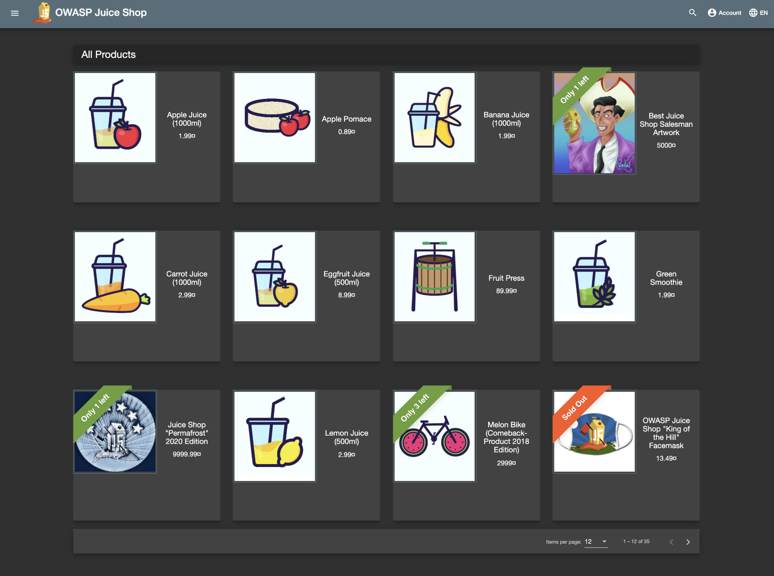
Test Website
Open-source Website
OWASP Juice Shop
URL: https://juice-shop.herokuapp.com/#/
GitHub: https://github.com/OWASP/owasp.github.io

Slide 4
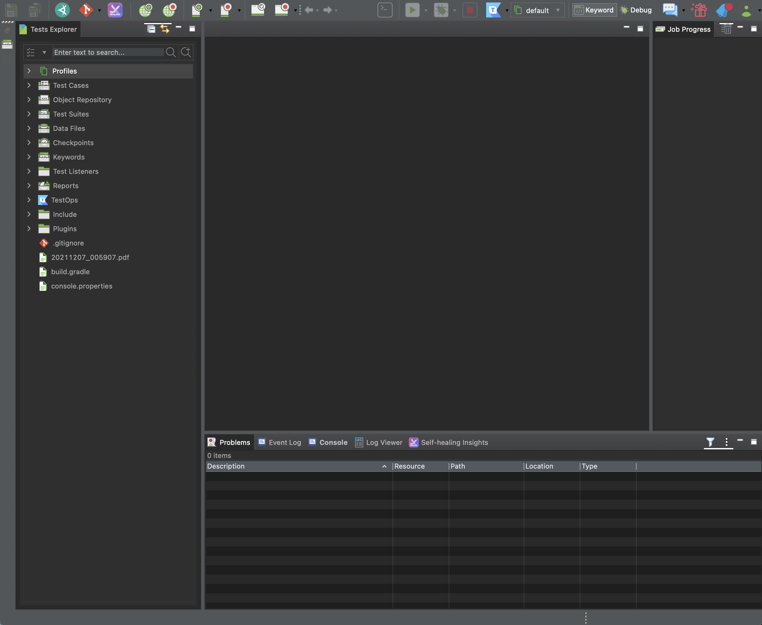
Automated Testing Software
Katalon Studio
User-friendly UI
Online websites, API, Mobile, Desktop Application
Test Recording
Testing Mode
Manual Mode
Script Mode

Slide 5
Testing Approach
Manual Mode
Create Test Case
Manually Execute Steps
Record Web
Run

Slide 6
Test Scenario
These areas in the application will be tested:
Module 1 – Login Form
Module 2 – Registration Form
Module 3 – Search Bar
Module 4 – User Profile ( Manual Testing)

Slide 7
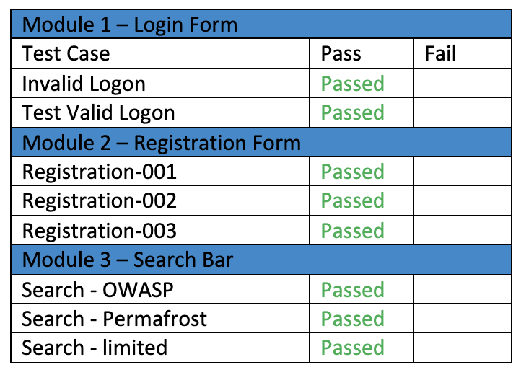
Test Case

Slide 8
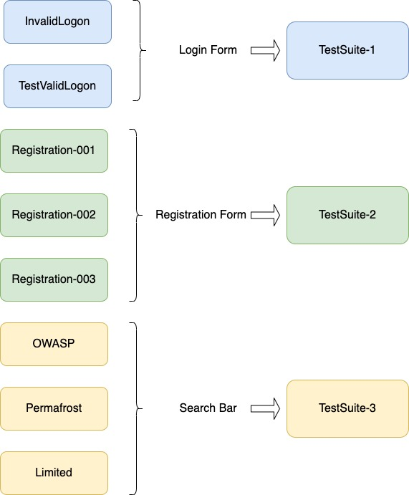
Report
Each TestSuite has a logical grouping of test cases with a single report summary.
TestSuite-1 related to test the Login Form.
TestSuite-2 related to test the Registration Form.
TestSuite-3 related to test the Search Bar.

Slide 9
Demo
URL: https://youtu.be/_OeoiTcOCkA

Slide 10
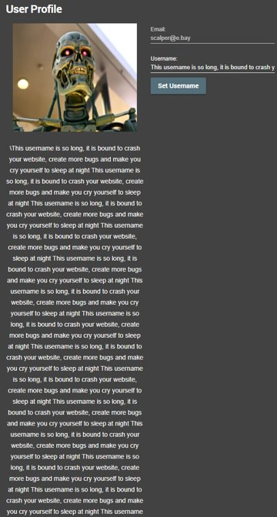
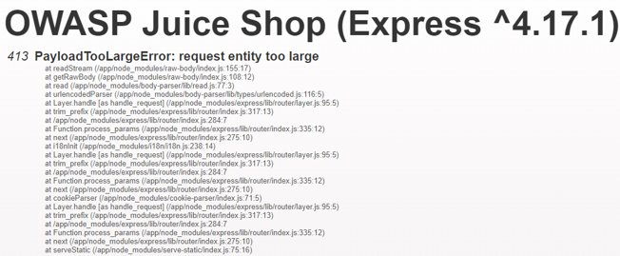
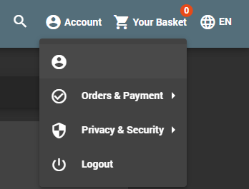
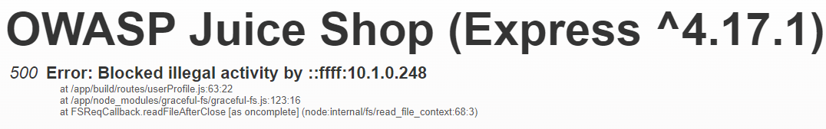
Manual Testing : User Profile
Undesirable properties:
No username length limit enforcement … until encountering 413 PayloadTooLargeError
No swear words filter
User accounts along with their profile are purged every few hours, but a persistent cookie keeps the user logged in to the zombie account
500 Error (Blocked illegal activity) if trying to view the user profile of the purged account

Slide 11
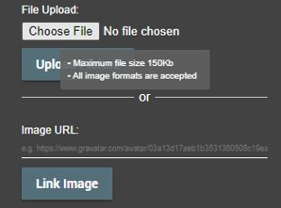
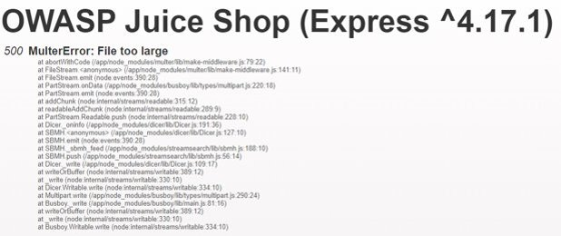
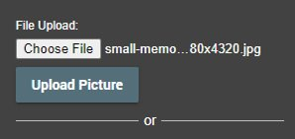
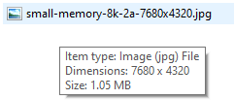
Manual Testing : User Profile image restrictions
File size: 1080 KB
When a file is too large (>150KB), it is correctly blocked from uploading
Leads to another error page (500 MulterError)

Slide 12
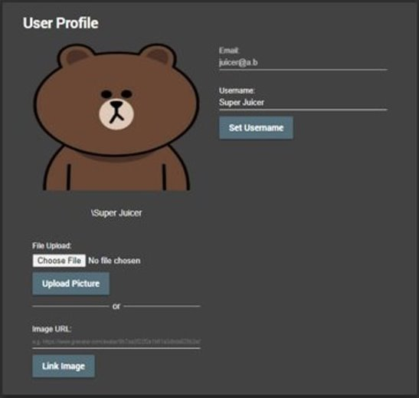
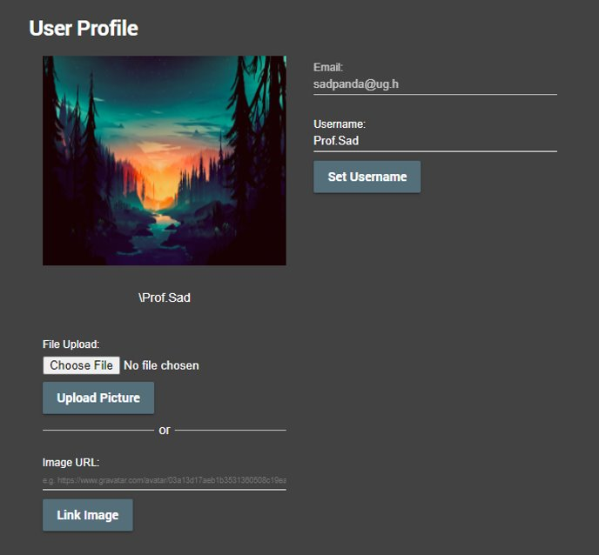
Manual Testing : User Profile correct usage
Small images are uploaded properly...
as well as links to larger images

Slide 13
Thank You!

